Slide 1

cowsay in golang

Slide 2

cowsay in golang by lukas nachtigall
- requirements:
- The program must be able to print a function a drawn picture of a cow
The program must be able to take an argument from the terminal input
The input from the terminal must be printed in a speech bubble that varies in size dependend on the size of the given input from the terminal

Slide 3
- Meta goals of the project: - Strengthenining ones ability of writing code in golang - Strengthening ones knowledge of basic go functions, syntax and structure - Strengthening ones critical thinking and problem solving abilities when it comes to breaking down the requirements for the given task and also for breaking down the requirements for the code

Slide 4
- Structure of the code: - package main - import needed packages - function with the ascii „drawing“ of the cow (or in my case the pinguin) - main function (including os.Args)

Slide 5
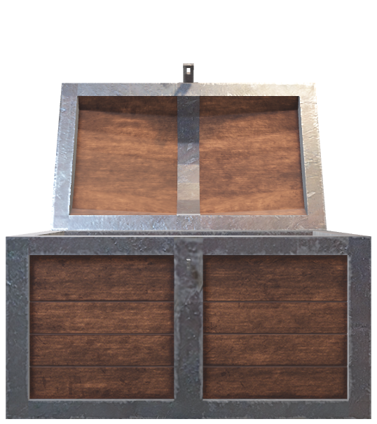
- what i learned: - breaking down the requirements - reiterate basic golang functions, syntax, strucuture - building code by using a divide and conquer solution finding strategy (break down requirements for the code into smaller sub requirements and build code for each sub requirements - - how to use os.Args

Slide 6

- -
Finish ☺

